Slide 1
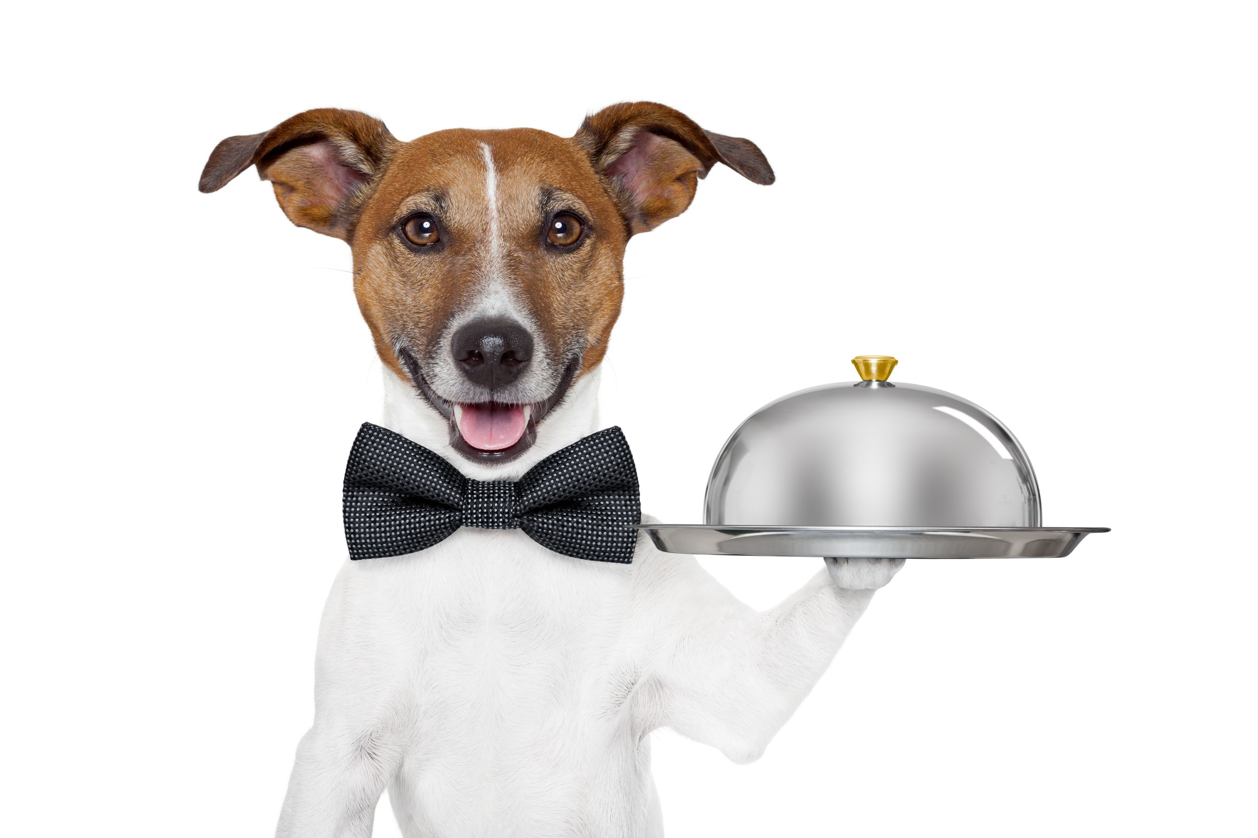
A Guide to Service Dogs in the Workplace
At Your SERVICE

Slide 2
Objectives:
Service Dog Education
Legal Schtuff
What to do
What NOT to do
See a LIVE demo

Slide 3
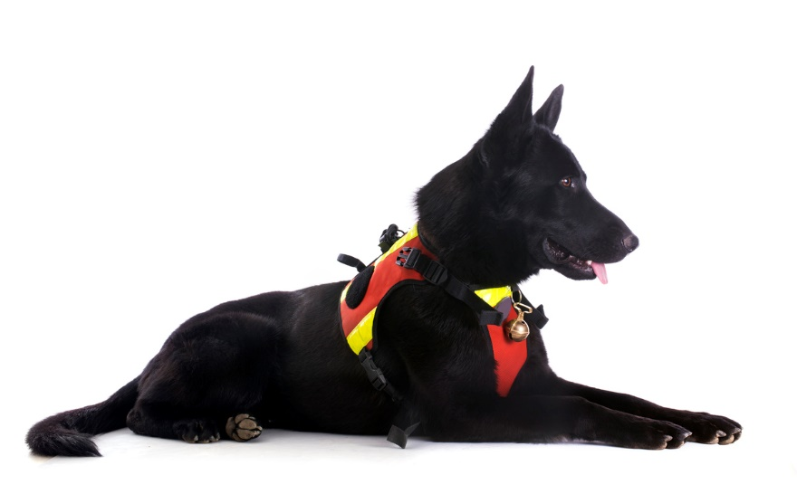
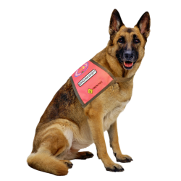
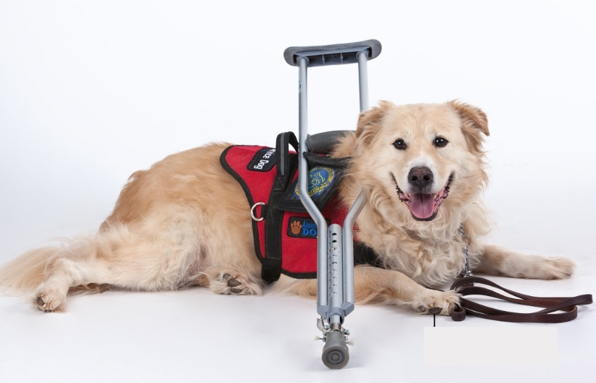
What is a Service Dog?
According to the American with Disabilities Act (ADA), a “service animal is a dog that is individually trained to do work or perform tasks for a person with a disability.” The task(s) performed by the dog must be directly related to the person's disability.

Slide 4
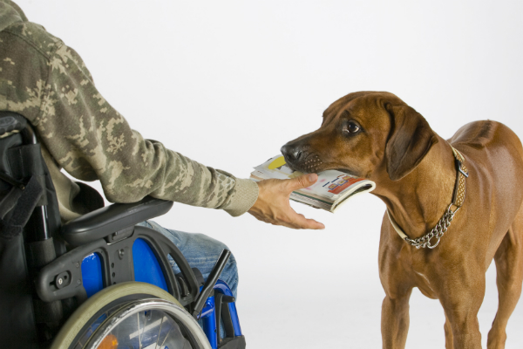
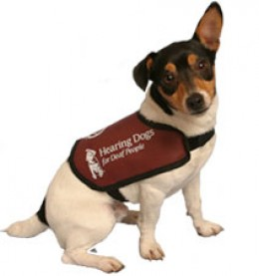
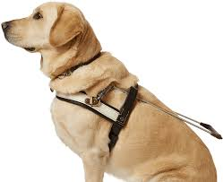
Types of Service Dogs
Mobility
Hearing Dogs
Guide Dogs

Slide 5
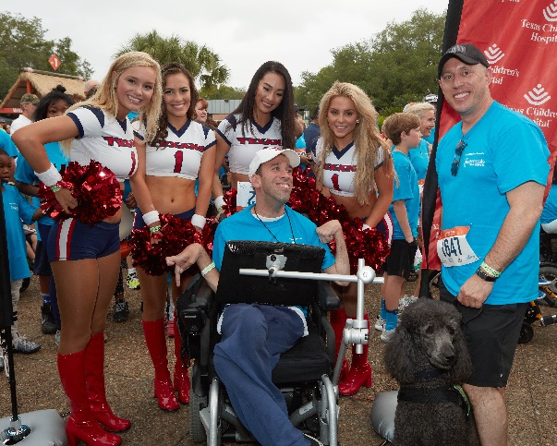
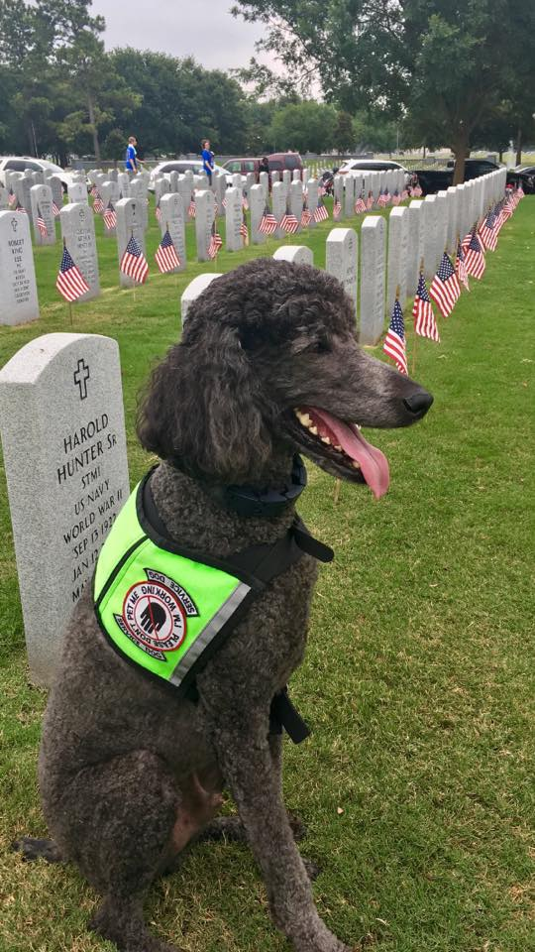
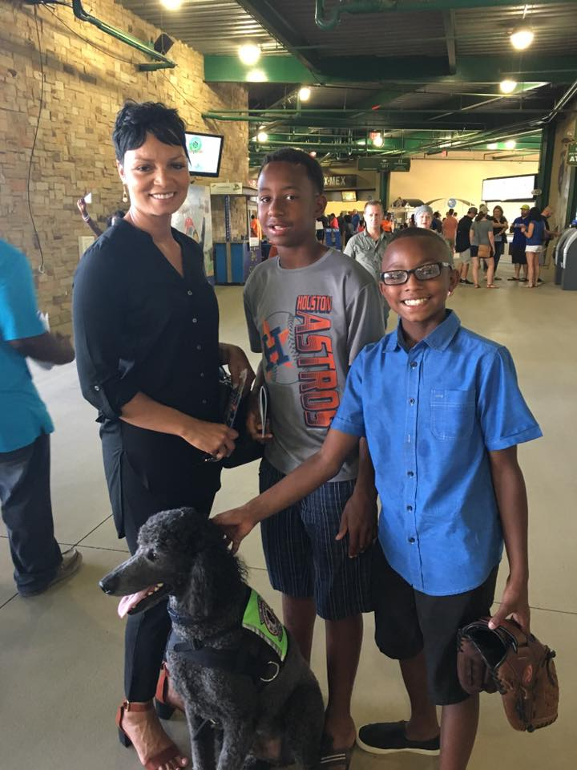
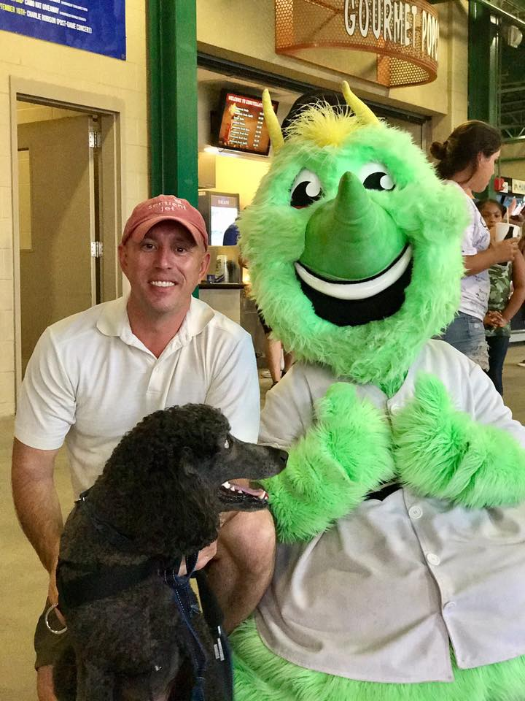
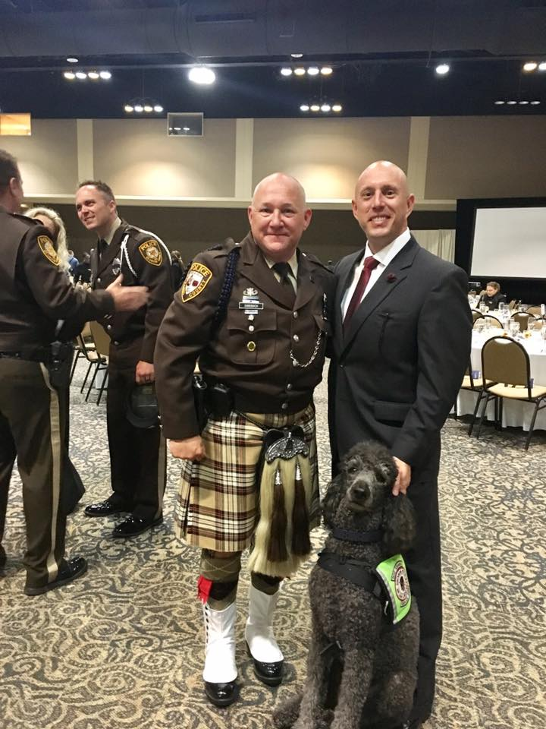
Introducing Colt the Wonder Dog
Psychiatric Service Dogs

Slide 6
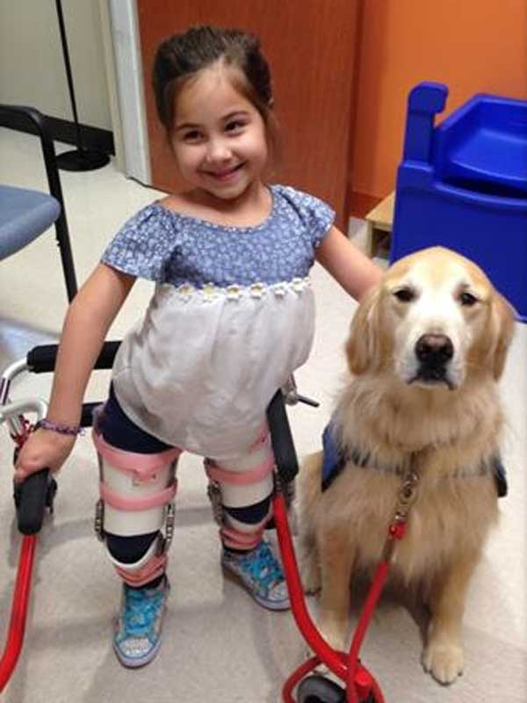
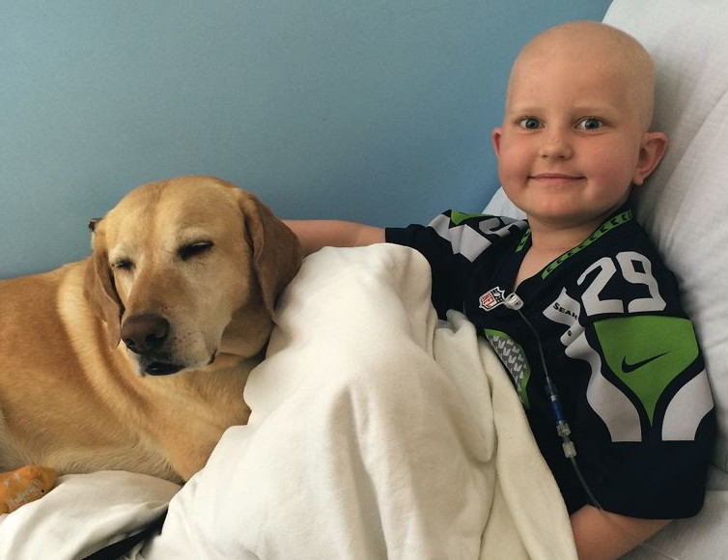
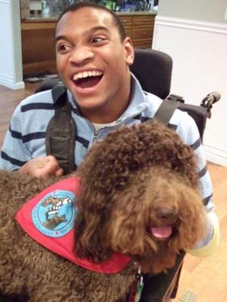
What is a Therapy Dog?
Dogs who go with their owners to volunteer in settings such as schools, hospitals, and nursing homes. From working with a child who is learning to read to visiting a senior in assisted living, therapy dogs and their owners work together as a team to improve the lives of other people.

Slide 7
Legal
Americans with Disabilities Act (ADA) and Texas Law
!
No vests, ID tag or harness
Dogs have vaccinations
Dog can be ANY breed
No professional training
Public Admittance
Criminal Penalty for Denial $300 + 30 hours
No proof or identification required

Slide 8
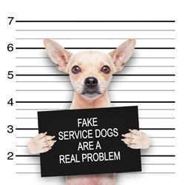
Legal
Americans with Disabilities Act (ADA) and Texas Law
Dogs must be under control
Tasks directly related to owner’s disability
Legitimate safety requirements
Owner must clean up any messes
Criminal Penalty for Fakes $300 + 30 hours
Abuse or neglect is subject to seizure

Slide 9
Legal
Two Questions You May Ask
?
“Is the dog a service animal required because of a disability?”
“What work or task has the dog been trained to perform?”

Slide 10
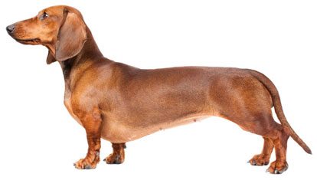
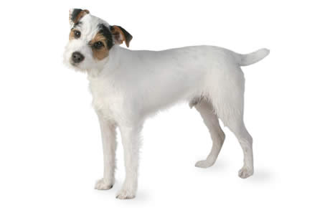
Did You KNOW?
Dachshund
Chihuahua
Jack Russell Terrier

Slide 11
What you should NOT do…
Touch the dog without permission from the HUMAN partner
Distract the dog (noises, food, petting)
Ask what the person’s disability is
Deny entry or charge extra
Hurt the dog

Slide 12
What you SHOULD do…
Compliment the owner on the dog
Inform your team there is a Service Dog present
Tell the owner you welcome Service Dogs
Talk to the person

Slide 13
Public Access Skills
Controlled loading/unloading out of a vehicle
Sit/Down on command in various situations
Controlled approach to a building & entry
Heeling through a building
Six-foot recall on lead
Control when the leash is dropped

Slide 14
Questions Answers

Slide 15
Connect Online
facebook.com/EasterSealsGreaterHouston
eastersealshouston.org
@eastersealshou
@WonderDogColt

